Slide 1

Introduction to
Statistics Distributions
Eslam Ahmed
Software Engineer

Slide 2
Probability Distribution

Slide 3
What is a Distribution?
Distribution is a mathematical function that provides the probabilities of occurrence of different possible outcomes in an experiment.
-- Wikipedia

Slide 4
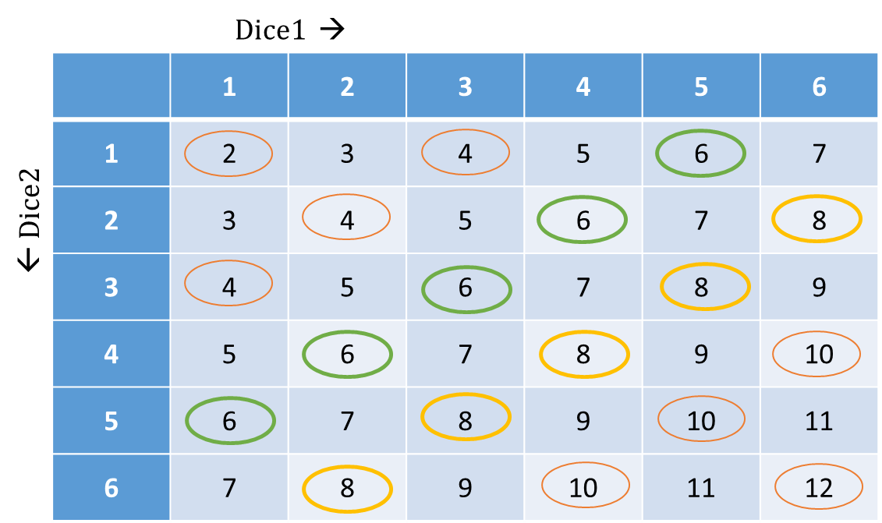
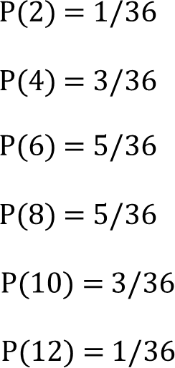
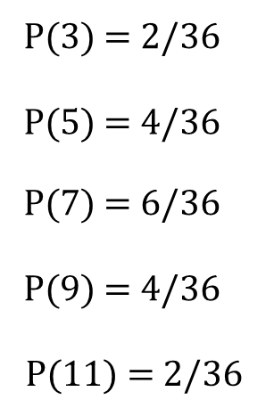
Distribution of Discrete Variables
Probability →
2 3 4 5 6 7 8 9 10 11 12
Sum →

Slide 5
Distribution of Continuous Variable
Temperature
30.6
31.4
31.2
32.1
32.2
32.7
33.4
33.8
34.6
What % of values are between
3
2
1
30-31 | → | 1/9 = 11.1%
31-32 | → | 2/9 = 22.2%
32-33 | → | 3/9 = 33.3%
33-34 | → | 2/9 = 22.2%
34-35 | → | 1/9 = 11.1%
30 – 31
31 – 32
32 – 33
33 – 34
34 – 35
Frequency Distribution with Bins

Slide 6
Distribution of Continuous Variable
Temperature
30.6
31.4
31.2
32.1
32.2
32.7
33.4
33.8
34.6
33.3%
3
22.22%
22.22%
2
11.1%
11.1%
1
30 – 31
31 – 32
32 – 33
33 – 34
34 – 35
30 – 31
31 – 32
32 – 33
33 – 34
34 – 35
Frequency Distribution with Bins
Probability of the Bins

Slide 7
Distribution of Continuous Variable
Temperature
30.6
31.4
31.2
32.1
32.2
32.7
33.4
33.8
34.6
33.3%
22.22%
22.22%
11.1%
11.1%
30 – 31
31 – 32
32 – 33
33 – 34
34 – 35
Probability of the Bins
Probability Density

Slide 8
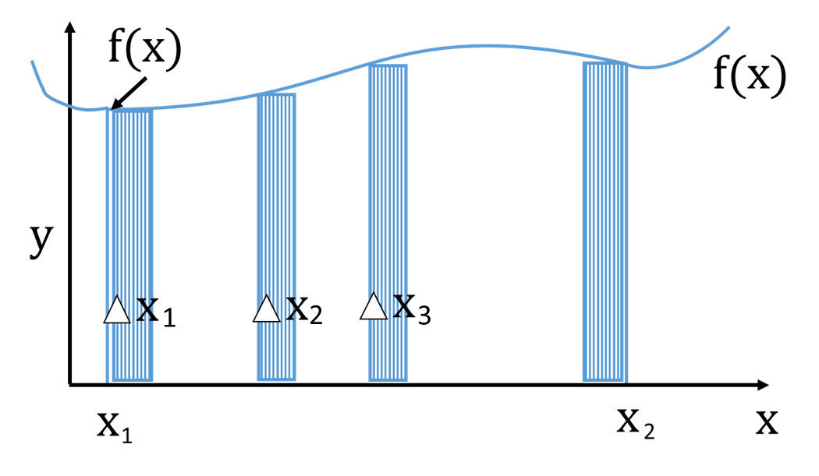
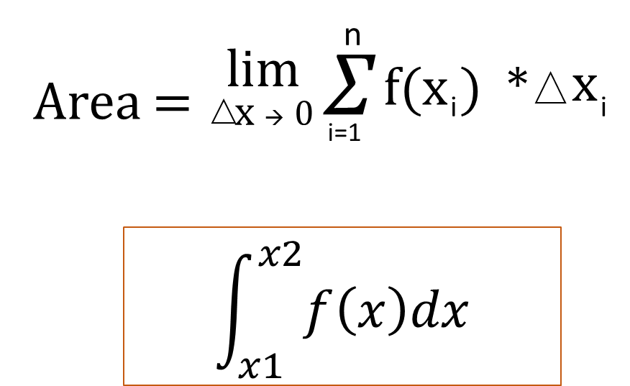
Distribution of Continuous Variable
0.33
0.22
0.11
Probability Density Function

Slide 9
Distribution of Continuous Variable
0.33
What is the probability that the temperature of the city will be exactly 32 degrees?
0.22
0.11
Probability Density Function

Slide 10

Distribution of Continuous Variable
0.33
What is the probability that the temperature of the city will be between 32 and 33 degrees?
0.22
0.11
32 33
Probability Density Function

Slide 11
Normal Distribution

Slide 12
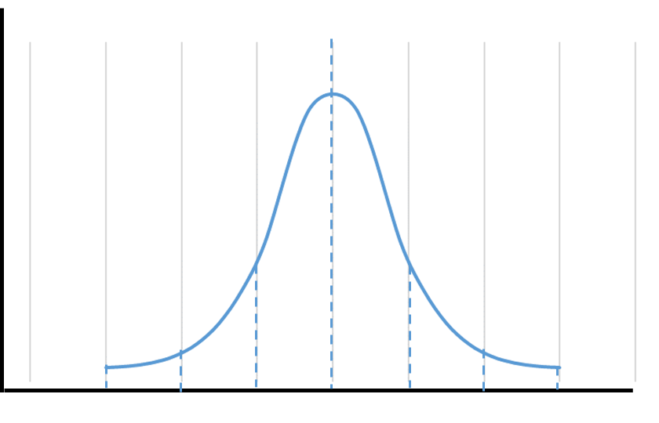
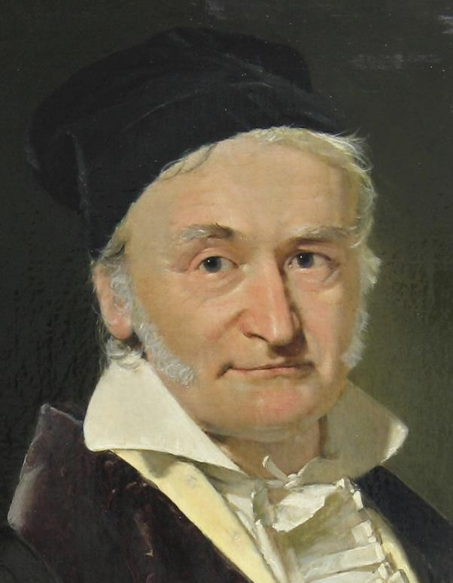
Normal Distribution – Bell Curve – Gaussian Distribution
𝜇
Carl Gauss

Slide 13
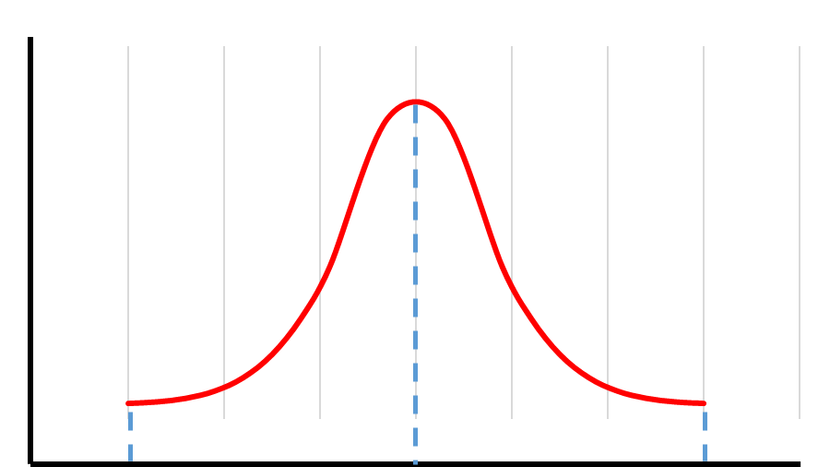
Examples of Normal Distribution
Diastolic Blood Pressure • Manufacturing
Arrival Time at office
50
82
110
94 mm
100 mm
106 mm
7:45 AM
8:00 AM
8:15 AM

Slide 14
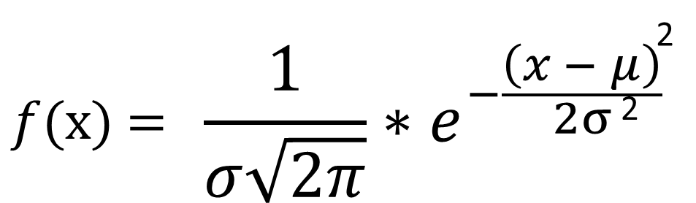
Normal Distribution – Bell Curve – Gaussian Distribution
34.2%
34.2%
13.6%
13.6%
2.15%
2.15%
𝜇 − 3𝜎
𝜇 − 2𝜎
𝜇 − 𝜎
𝜇
𝜇 + 𝜎
𝜇 + 2𝜎
𝜇 + 3𝜎
68.2%
95.4%
99.7%

Slide 15
Characteristics of Normal Distribution
Mean defines the centre of the graph
Mean = Median = Mode
Standard Deviation defines the width of the graph
Entire distribution can be specified using mean and variance
The total area under the curve is 1
Probability at a given point is zero
68.2% of the area under the curve is within 1 σ of the mean
𝜇
95.4% of the area under the curve is within 2 σ of the mean
99.7% of the area under the curve is within 3 σ of the mean

Slide 16
Standard Normal Distribution

Slide 17

Z-Score
34.2%
34.2%
13.6%
13.6%
2.15%
2.15%
15.8%
𝜇 − 3𝜎
𝜇 − 2𝜎 𝜇 − 𝜎
𝜇
𝜇 + 𝜎
𝜇 + 2𝜎
𝜇 + 3𝜎

Slide 18
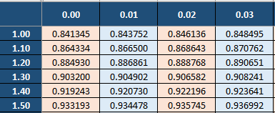
Z-Score Table
Standard Normal Table
Provides Cumulative Distribution Function Values

Slide 19
Importance of Standard Normal Distribution and Z-Score
Standardises the readings or scores
Calculate the probability within the normal distribution
Comparison of two records from different normal distribution at two different scale
Experience in years | Salary
1 | $ 4,500
4 | $ 7,200
4 | $ 6,500
6 | $ 8,500
7 | $ 8,900

Slide 20
Sampling Distribution

Slide 21

Population and Sample
Population
Sample
2
x, S, S
μ, σ, σ ²
2
x, S, S
2
x, S, S

Slide 22
Population and Sample
Yrs
3
5
6
7
7
8
9
9
10
10
7.4
Sample 1 | 7.33
5
7
10
Sample 4 | 8.67
8
9
9
Sample 7 | 7.66
3
10
10
Sample 2 | 7.33
3
9
10
Sample 5 | 7.67
6
7
10
Sample 8 | 6
3
7
8
Sample 3 | 7
6
7
8
Sample 6 | 8.33
5
10
10
Sample 9 | 6.33
5
6
8

Slide 23



Sampling Distribution
Sample Mean
5
Distribution of the Statistic of the Sample,
7.33
7.33
4
Mean
Standard Deviation
Variance
Range
7
3
8.67
7.67
2
8.33
1
7.66
6
6-7
7-8
8-9
6.33

Slide 24
Central Limit Theorem

Slide 25
Central Limit Theorem
When independent random variables are added, their properly normalized sum tends toward a normal distribution even if the original variables themselves are not normally distributed.
-- Wikipedia

Slide 26
Central Limit Theorem
𝑥 𝑥 𝑥 | $ 110,000 $ 105,000 $ 127,000 | $ 140,000 |  | $ 110,000 $ 121,000 | 𝑥 𝑥 𝑥 | $ 115,000 $ 121,000 $ 107,000
𝑥 𝑥 𝑥 𝑥 𝑥 𝑥 𝑥 | $ 117,000 $ 108,000 $ 105,000 $ 120.000 $ 125,000 $ 130,000 $ 105,000 | $ 142,000 |  | 𝑥 𝑥 𝑥 𝑥 𝑥 𝑥 𝑥 𝑥 𝑥 𝑥 𝑥 𝑥 𝑥 𝑥 𝑥 𝑥 𝑥 𝑥 𝑥 𝑥 𝑥 $ 128,000 | 𝑥 𝑥 𝑥 𝑥 𝑥 𝑥 𝑥 | $ 119,200 $ 132,000 $ 131,000 $ 135.000 $ 130,000 $ 121,000 $ 115,000
$ 111,000

Slide 27
Importance of Sampling
Inferences about the population using a small subset
Efficient in terms of time and money
Flexible to approximate many sums and integrals in Machine Learning
Sum or integral can be intractable/impossible or hard to define

Slide 28
Importance of Central Limit Theorem
$ 128,000

Slide 29
μ = μ
Importance of Central Limit Theorem
Valid Sample → Population Inferences
𝑥
Population Information → Valid Sample
Population and Sample → Sample Verification
σ
σ_{𝑥} =
Multiple Valid Samples → Infer the origin
𝑛
$ 128,000

Slide 30
Confidence Interval

Slide 31
Normal and Sampling Distribution
34.2%
34.2%
13.6%
13.6%
2.15%
2.15%
Sampling distribution of Mean

Slide 32
Point Estimate
A single value which is used to serve as a "best guess" or "best estimate" of an unknown population parameter.
-- Wikipedia
𝑥
~
μ

Slide 33
~
Interval Estimate
𝑥
84
μ
?
𝑥1
𝑥₂
Range

Slide 34
~
Interval Estimate
𝑥
84
μ
?
𝑥1
𝑥₂
Confidence Interval

Slide 35





μ
Interval Estimate
Interval
Interval
𝑥
𝑥

Slide 36

μ
Interval Estimate
Interval
Interval
𝑥
𝑥

Slide 37
μ
Interval Estimate
How Far Sample Mean is
from the population Mean?
Standard Error
Interval
𝑥
𝑥

Slide 38
μ
Standard Error
SE – Just Another Statistical Jargon
Standard Error is the Standard Deviation of the
Sampling Distribution of the Mean of the Samples
σ
SE = σ_{𝑥}
=
𝑛

Slide 39
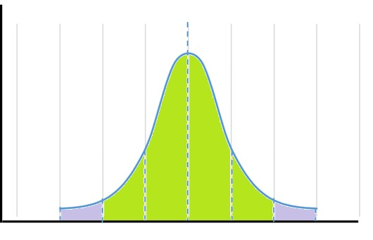
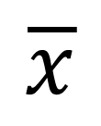
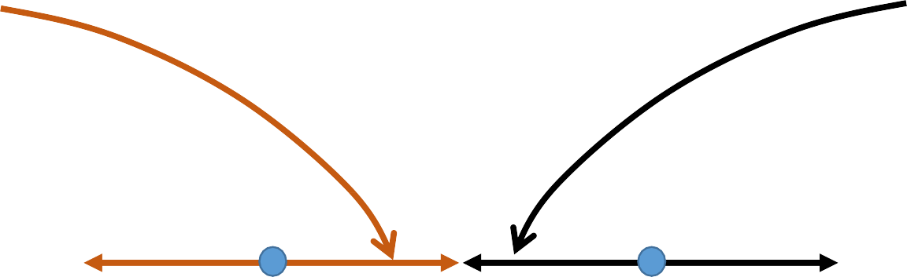
Reliability Factor
A Number based on the Sampling Distribution of the point estimate and the degree of confidence.
Sample Mean
95.4%
𝑥 + 2σ
𝑥 - 2σ
-3σ -2σ -1σ
μ
+1σ +2σ +3σ

Slide 40
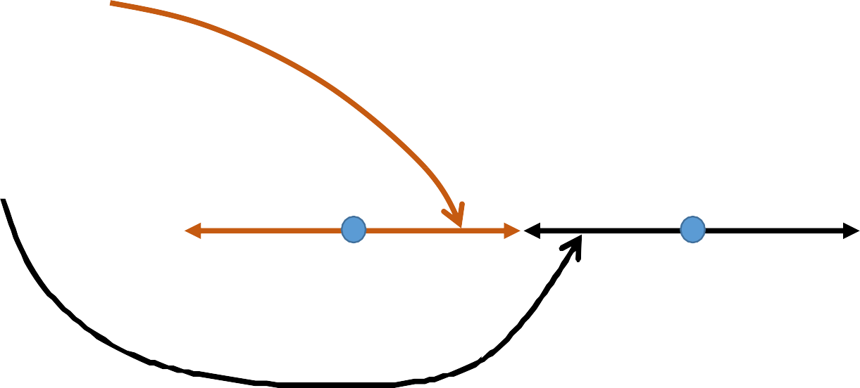
Reliability Factor
A Number based on the Sampling Distribution of the point estimate and the degree of confidence.
Sample Mean
𝑥 + 2σ
𝑥 - 2σ
We are 95.4% confident that the Sample Mean will be within + 2σ and the Population Mean will be within an interval of + 2σ.
-3σ -2σ -1σ
μ
+1σ +2σ +3σ

Slide 41
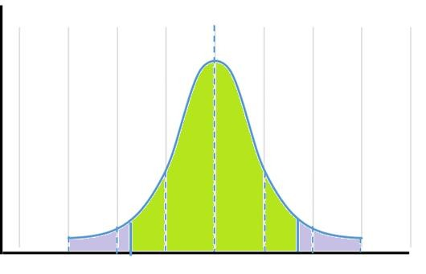
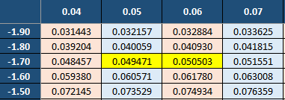


Reliability Factor
A Number based on the Sampling Distribution of the point estimate and the degree of confidence.
α = 1 – Confidence Level
Confidence Level = 1 – α
z-Score
^{Z}α/2 ⁼
-1.7 + 0.05 = -1.65
-z-value
0.05
0.05
μ
-3σ -2σ -1σ +1σ +2σ +3σ
Area not considered
α

Slide 42








Reliability Factor
A Number based on the Sampling Distribution of the point estimate and the degree of confidence.
90% CI does not mean there is 90% probability that population mean will be in the given interval.
If we draw a sample and calculate its mean, we are 90% confident that the population mean will be within an interval of,
𝑥 + 1.65 * σ
90% intervals will have population mean within the interval limits.
9 out of 10 random intervals will have population mean within the range.

Slide 43
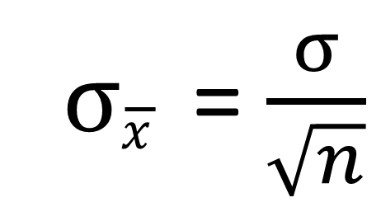
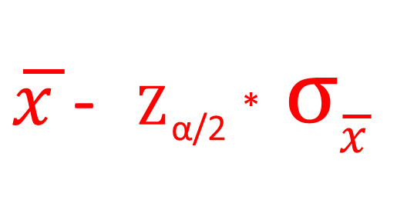
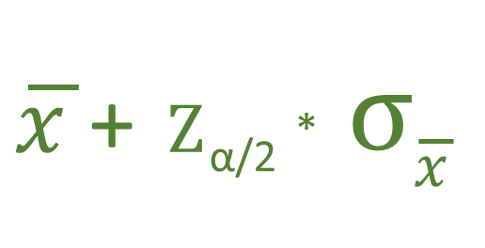

Confidence Interval
Confidence Interval = Point Estimate
+ Reliability Factor * Standard Error
𝑥
Lower Endpoint
^{Z} α/2
Upper Endpoint
α = 1 – Confidence Level

Slide 44
Thank You!

